Slide 1




SOFTWARE GROUP PROJECt
WEBGAMe APPLICATION
GAmes3

Slide 2
CONTENTS
Introduction
DOMAIN AREA
IMPLEMENTATION
PUZZLE WORLD
MEMORY CARD GAME
Image finding game(like where’s waldo game)
REFERENCES

Slide 3
INTRODRUCTION
Defination : A WEBSITE THAT HAVE THE OPTION OF THREE GAMES WHICH INCLUDES PUZZLE WORLD,MEMORY CARD GAME AND image finding game.
The basic idea behind the game or the website app was to nurture our skills in website development and to take it to a next level using css.

Slide 4


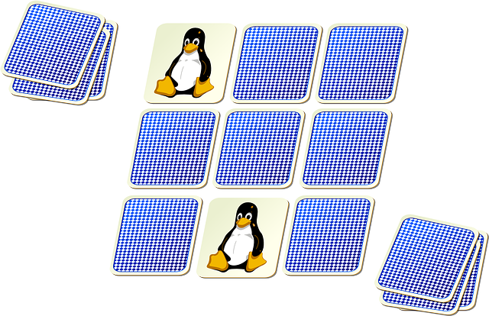
DOMAIN AREA
IT IS WEBGAME Application
A website which has the option of playing small games
These are some photos that depict our games precisely.

Slide 5



IMPLEMANTATION
WE MADE THIS GAME THE USE OF HTML,CSS AND JAVASCRIPT(JS).
HTML FOR TAXING.
CSS FOR WEBDECORATION.
JAVASCRIPT FOR handling the EVENTS AND some ANIMATIONS.

Slide 6
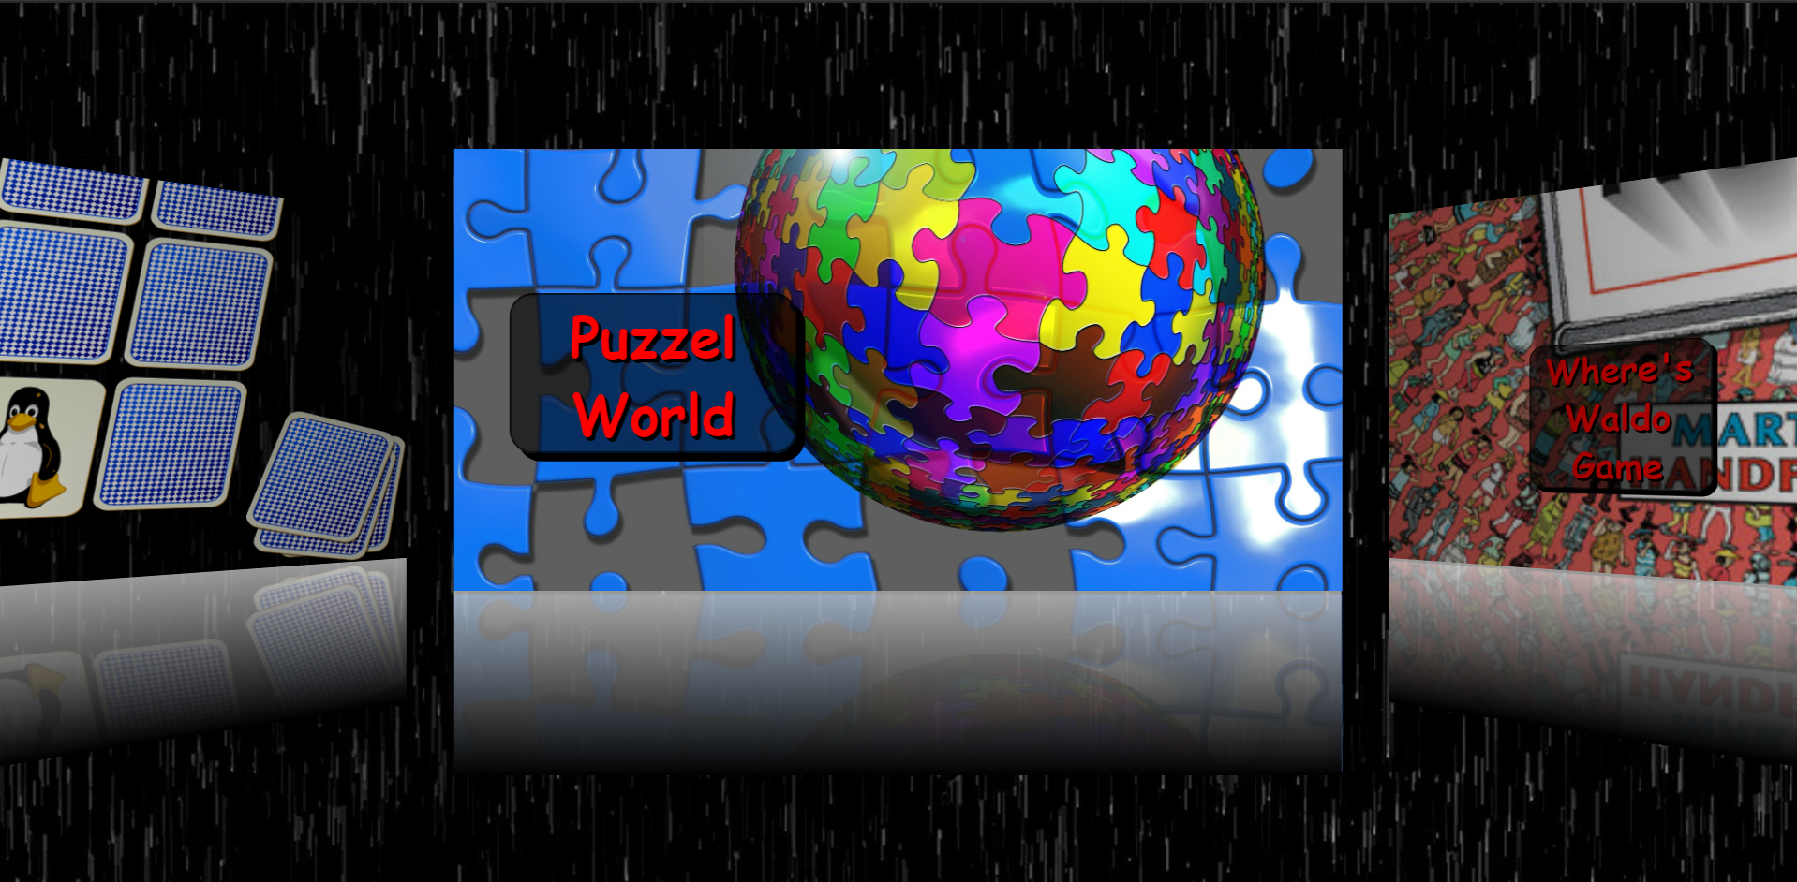
Second page(Games)

Slide 7
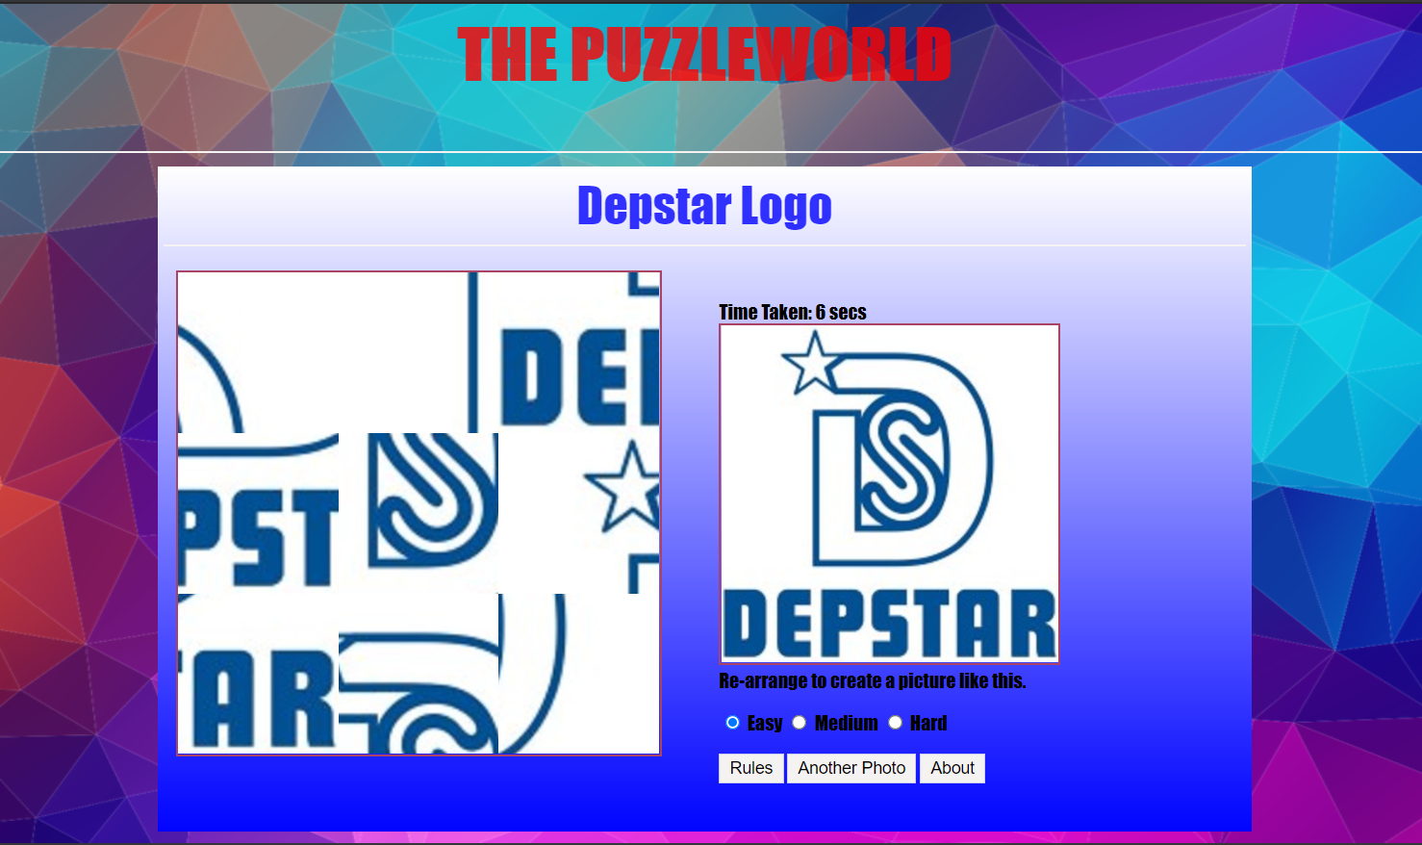
Puzzle world
This is a basic jumbelword type image game.
In this game user has to rearrange the images and make a perfect picture
Example is shown below.

Slide 8
Memory card game
In this game we give user play board which contains some types of hidden pictures.
the user has to make the same pair of those pictures.
When user pairs all images then the user wins.

Slide 9
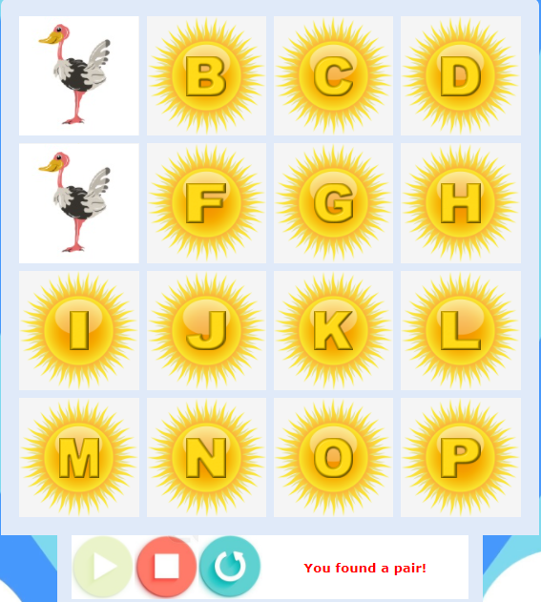
Memory card game cont.

Slide 10
Image finding game
The third game is simple as its name you have to find a particular thing which is asked of you in a big picture like where’s waldo puzzles

Slide 11
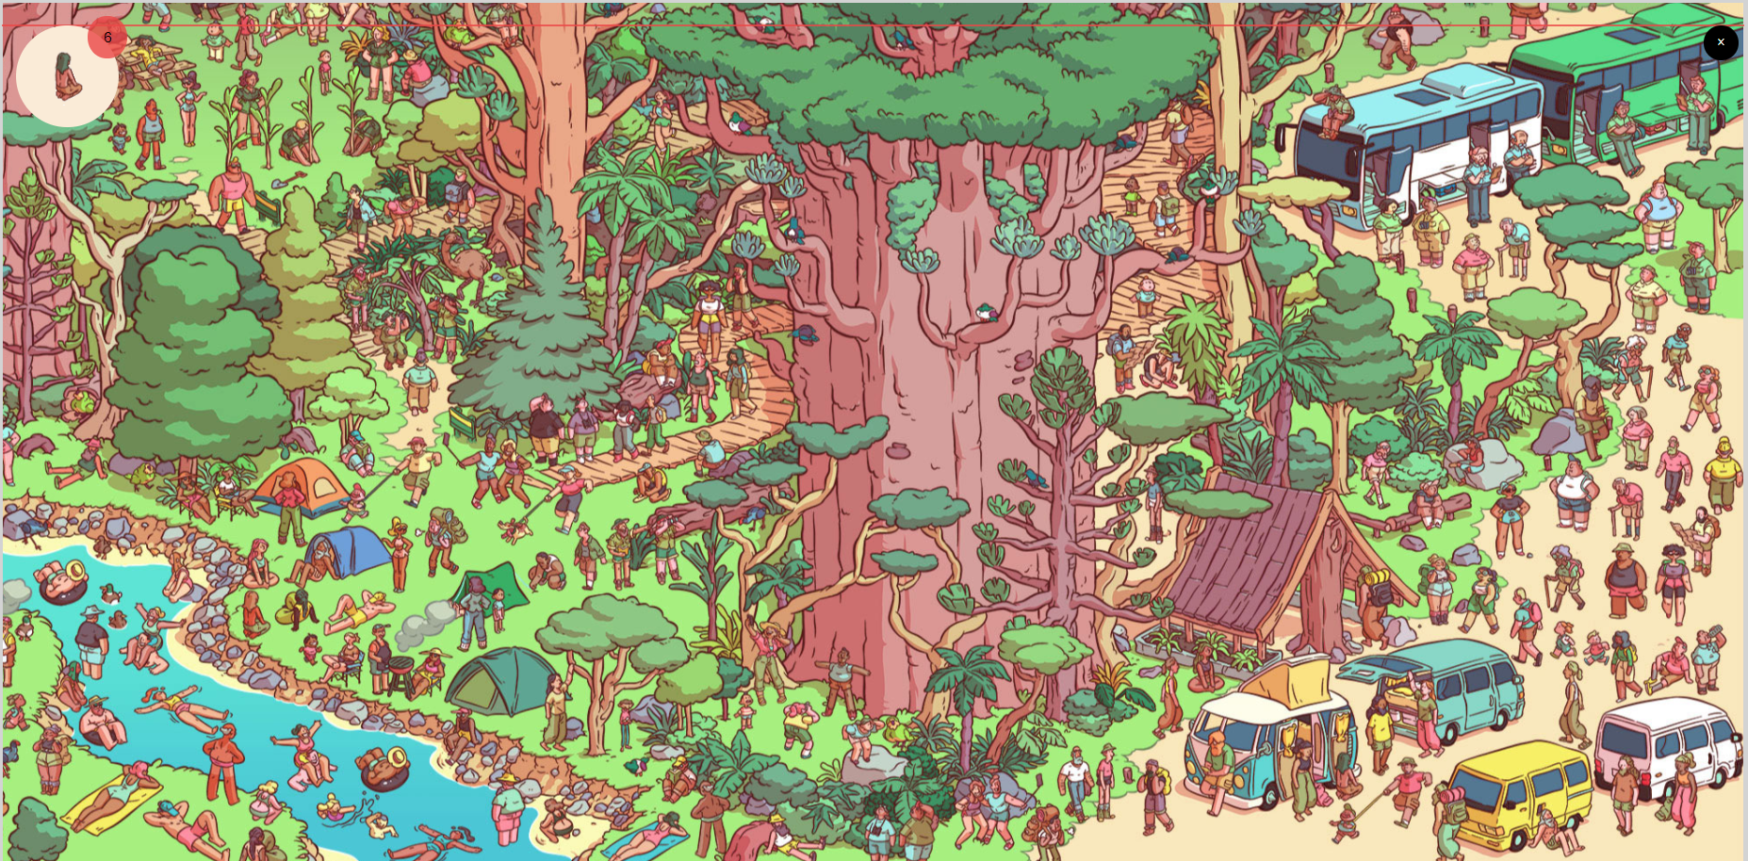
Image finding game CONT.

Slide 12
references
https://codewithharry.com/playlist/web-development
For images : https://pixabay.com/
https://www.youtube.com/watch?v=QocWxqA28Ds&list=PLbu98QxRH81KxxMclY_ZRmm4Dac-n7cSA
https://nicepage.com
And some other sites…..

Slide 13
Thank you
BY-
Aamir Ansari (19dce002)
Anshul gorasiya(19DCE034)
sanat kakadiya (19dce050)

